Slide 1
Microprocessor Cortex-M3 Instruction Set
Seung-Ho Lim
Hankuk University of Foreign Studies

Slide 2
Agenda
Assembly Basics
Endian format
Cortex-M3 Registers & Memory
Corex-M3 Instruction Set Architecture

Slide 3
Assembly Basics
Assembler Language: Basic Syntax
Common format for assembler code
Label
The address of the instructions can be determined using the label
Opcode
Encoded symbol of instruction that let processor execute
Operands
Values or registers to be executed by opcode
Comments
Additional explain for the statements. Identified by ;
label
opcode operand1, operand2, ...; Comments

Slide 4
Assembly Basics
Assembler Language examples
Opcode, operands, comment
Define constant using EQU (similar to #define in c)
MOV R0, #0x12 ; Set R0 = 0x12 (hexadecimal)
MOV R1, #'A' ; Set R1 = ASCII character A
NVIC_IRQ_SETEN0 EQU 0xE000E100
NVIC_IRQ0_ENABLE EQU 0x1
...
LDR R0,=NVIC_IRQ_SETEN0; ; LDR here is a pseudo-instruction that
; convert to a PC relative load by
; assembler.
MOV R1,#NVIC_IRQ0_ENABLE ; Move immediate data to register
STR R1,[R0] ; Enable IRQ

Slide 5
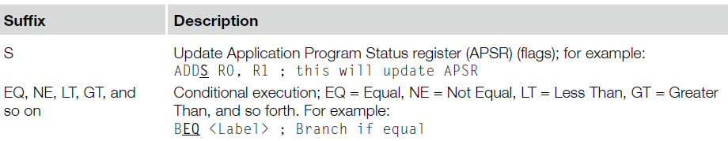
Assembly Basics
Assembler Language: Use of Suffixes
In assembler for ARM processors, instructions can be followed by suffixes
The conditional execution suffixes are usually used for branch instructions

Slide 6
The Endianess religious war: 288 years and counting!
Modern version
Danny Cohen
IEEE Computer, v14, #10
Published in 1981
Satire on CS religious war
Historical Inspiration
Jonathan Swift
Gulliver's Travels
Published in 1726
Satire on Henry-VIII’s split with the Church
Now a major motion picture!
Little-Endian
LSB is at lower address
Memory Value
Offset (LSB) (MSB)
====== ===========
uint8_t a = 1; 0x0000 01 02 FF 00
uint8_t b = 2;
uint16_t c = 255; // 0x00FF
uint32_t d = 0x12345678; 0x0004 78 56 34 12
Big-Endian
MSB is at lower address
Memory Value
Offset (LSB) (MSB)
====== ===========
uint8_t a = 1; 0x0000 01 02 00 FF
uint8_t b = 2;
uint16_t c = 255; // 0x00FF
uint32_t d = 0x12345678; 0x0004 12 34 56 78

Slide 7
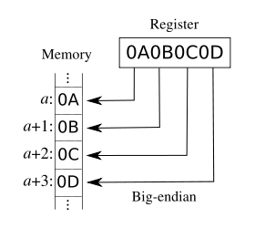
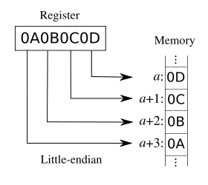
Addressing: Big Endian vs Little Endian
Endian-ness: ordering of bytes within a word
Little - increasing numeric significance with increasing memory addresses
Big – The opposite, most significant byte first
MIPS is big endian, x86 is little endian

Slide 8
ARM Cortex-M3 Memory Formats (Endian)
Default memory format for ARM CPUs: LITTLE ENDIAN
Bytes 0-3 hold the first stored word
Bytes 4-7 hold the second stored word
Processor contains a configuration pin BIGEND
Enables system developer to select format:
Little Endian
Big Endian (BE-8)
Pin is sampled on reset
Cannot change endianness when out of reset
Source: [ARM TRM] ARM DDI 0337E, “Cortex-M3 Technical Reference Manual,” Revision r1p1, pg 67 (2-11).

Slide 9
Instruction Set Architecture
Instruction Set
The complete details of each instruction are available in the ARM v7-M Architecture Application Level Reference Manual
Cortex-M3 Instruction Type
16-bit/32-bit Data Processing Instructions
Branch Instructions
16-bit/32-bit Load and Store Instructions
Etc.
Coprocessor instructions

Slide 10
An ISA defines the hardware/software interface
A “contract” between architects and programmers
Register set
Instruction set
Addressing modes
Word size
Data formats
Operating modes
Condition codes
Calling conventions
Really not part of the ISA (usually)
Rather part of the ABI
But the ISA often provides meaningful support.

Slide 11
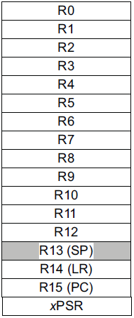
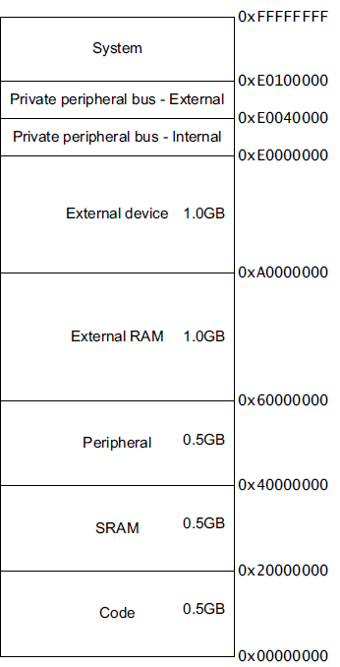
ARM Cortex-M3 ISA
Instruction Set
Register Set
Address Space
Branching
Data processing
Load/Store
Exceptions
Miscellaneous
32-bits
32-bits
Endianess
Endianess

Slide 12
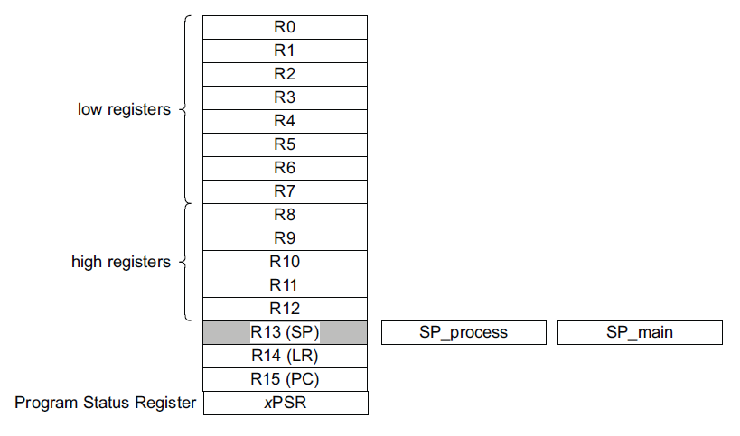
Registers for ISA
Note: there are two stack pointers!
SP_process (PSP) used by:
Base app code (when not running an exception handler)
SP_main (MSP) used by:
OS kernel
Exception handlers
App code w/ privileded access
Mode dependent

Slide 13
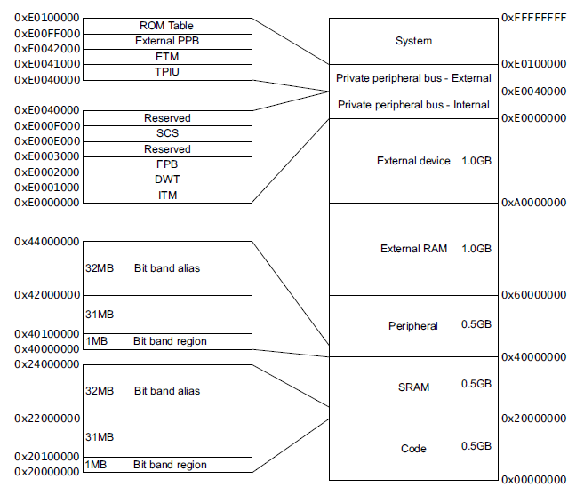
Address Space

Slide 14
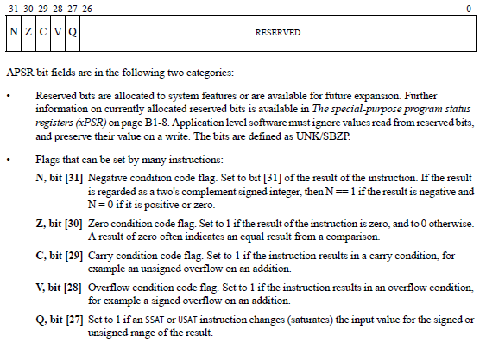
ARM Instruction Set Architecture
32-bits
32-bits
mov r0, #4
ldr r1, [r0,#8]
r1=mem((r0)+8)
bne loop
subs r2, #1
Endianess
Endianess

Slide 15
Instruction Descriptions Details
1) Assembler Language: Moving Data
One of the most basic functions in a processor is transfer of data.
In the Cortex-M3, data transfers can be of one of the following types:
Moving data between register and register
Ex) MOV R8, R3
Moving data between memory and register
Ex) STMIA.W R8!, {R0-R3}
LDR.W R0, [R1, #offset]!
Moving data between special register and register
Ex) MRS R0, PSR
Moving an immediate data value into a register
Ex) MOVS R0, #0x12

Slide 16
Instruction Descriptions
2) Assembler Language: Processing Data
Processing data means Addition, Subtraction, Multiply, Division
Aside from ADD instructions, the arithmetic functions that the Cortex-M3 supports include subtract (SUB), multiply (MUL), and unsigned and signed divide (UDIV/SDIV).
Addition
ADD R0, R0, R1 ; R0 = R0 + R1
ADDS R0, R0, #0x12 ; R0 = R0 + 0x12
ADD.W R0, R1, R2 ; R0 = R1 + R2
Subtraction
SUB R0, R0, R1 ; R0 = R0 - R1
SUBS R0, R0, #0x12 ; R0 = R0 - 0x12
SUB.W R0, R1, R2 ; R0 = R1 - R2
Multiply
MUL Rd, Rm ; Rd = Rd * Rm
MUL.W Rd, Rn, Rm ; Rd = Rn * Rm
Division
UDIV Rd, Rn, Rm ; Rd = Rn/Rm
SDIV Rd, Rn, Rm ; Rd = Rn/Rm

Slide 17
Instruction Descriptions
3) Assembler Language: Call and Unconditional Branch
Jump to the specified address that is expected to be executed
B label ; Branch to a labeled address
BX reg ; Branch to an address specified by a register
4) Assembler Language: Combined Compare and Conditional Branch
a simple compare with zero and conditional branch operations.
CBZ (compare and branch if zero)
CBNZ (compare and branch if nonzero).

Slide 18
Instruction Descriptions Details
Four Type of Instructions
Assembler Language: Moving Data
Data moving from resisters to registers
Data moving from registers to memory
Assembler Language: Processing Data
Data arithmetic operations
Data logical operations
Assembler Language: branch
Call and Unconditional Branch
Combined Compare and Conditional Branch
program flow control
Assembler Language: Use of Suffixes

Slide 19
Instruction Descriptions Details
1) Assembler Language: Moving Data
One of the most basic functions in a processor is transfer of data.
In the Cortex-M3, data transfers can be of one of the following types:
Moving data between register and register
Ex) MOV R8, R3
Moving data between memory and register
Ex) STMIA.W R8!, {R0-R3}
LDR.W R0, [R1, #offset]!
Moving data between special register and register
Ex) MRS R0, PSR
Moving an immediate data value into a register
Ex) MOVS R0, #0x12

Slide 20
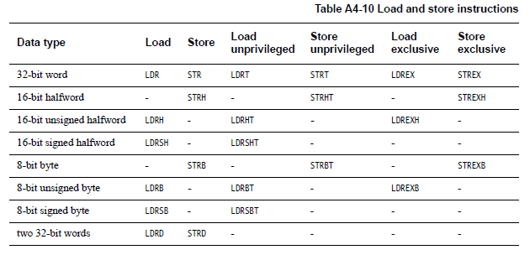
Assembler Language: Moving Data
Load/Store instructions

Slide 21
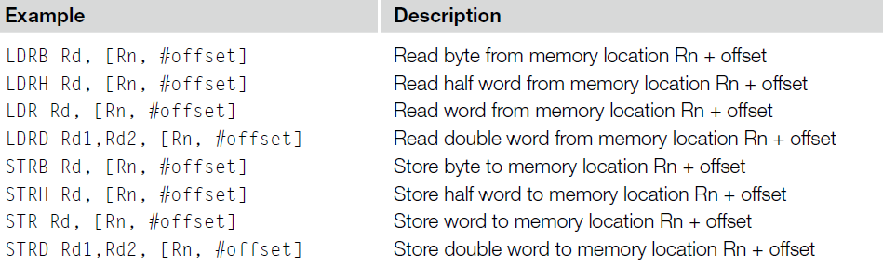
Addressing Modes
Offset Addressing
Offset is added or subtracted from base register
Result used as effective address for memory access
[<Rn>, <offset>]

Slide 22
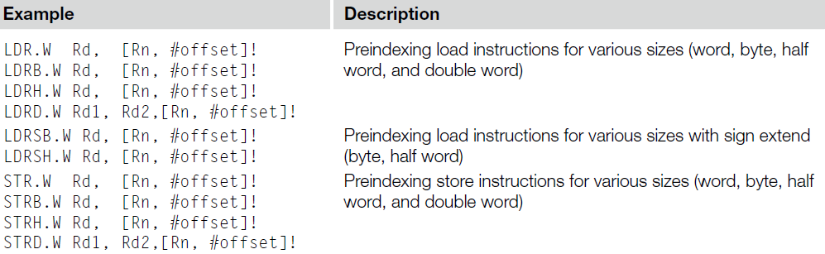

Addressing Modes
Pre-indexed Addressing
Offset is applied to base register
Result used as effective address for memory access
Result written back into base register
[<Rn>, <offset>]!
The exclamation mark (!) in the instruction specifies whether the value should be updated
Example

Slide 23
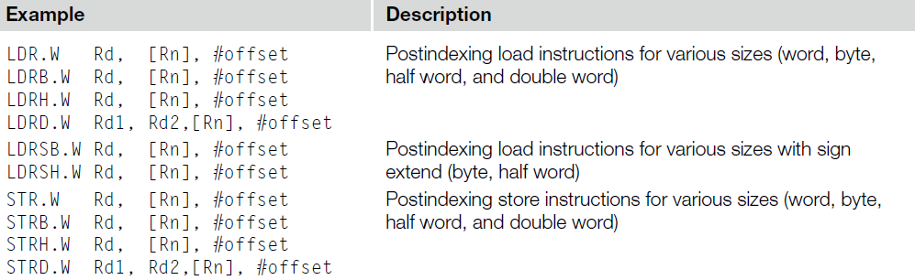

Addressing Modes
Post-indexed Addressing
The address from the base register is used as the EA
The offset is applied to the base and then written back
[<Rn>], <offset>
Example

Slide 24
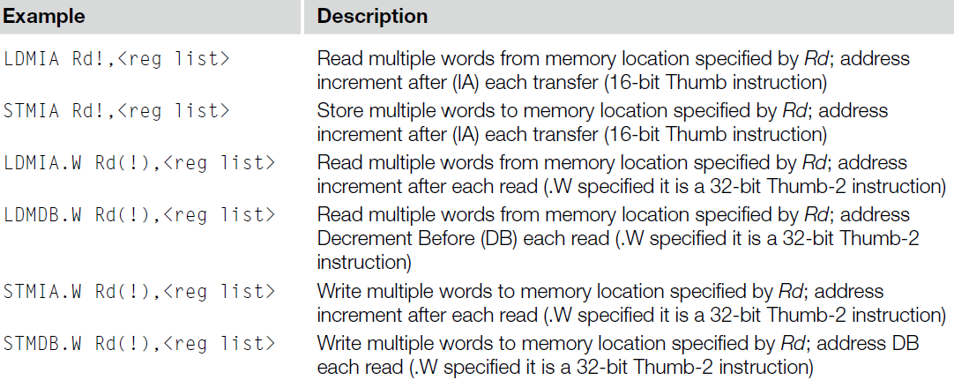
Multiple load/store
Multiple Load and Store operations can be combined into single instructions called LDM (Load Multiple) and STM (Store Multiple)
The exclamation mark (!) in the instruction specifies whether the register Rd should be updated after the instruction is completed

Slide 25
Instruction Descriptions
2) Assembler Language: Processing Data
Processing data means Addition, Subtraction, Multiply, Division
Aside from ADD instructions, the arithmetic functions that the Cortex-M3 supports include subtract (SUB), multiply (MUL), and unsigned and signed divide (UDIV/SDIV).
Addition
ADD R0, R0, R1 ; R0 = R0 + R1
ADDS R0, R0, #0x12 ; R0 = R0 + 0x12
ADD.W R0, R1, R2 ; R0 = R1 + R2
Subtraction
SUB R0, R0, R1 ; R0 = R0 - R1
SUBS R0, R0, #0x12 ; R0 = R0 - 0x12
SUB.W R0, R1, R2 ; R0 = R1 - R2
Multiply
MUL Rd, Rm ; Rd = Rd * Rm
MUL.W Rd, Rn, Rm ; Rd = Rn * Rm
Division
UDIV Rd, Rn, Rm ; Rd = Rn/Rm
SDIV Rd, Rn, Rm ; Rd = Rn/Rm

Slide 26
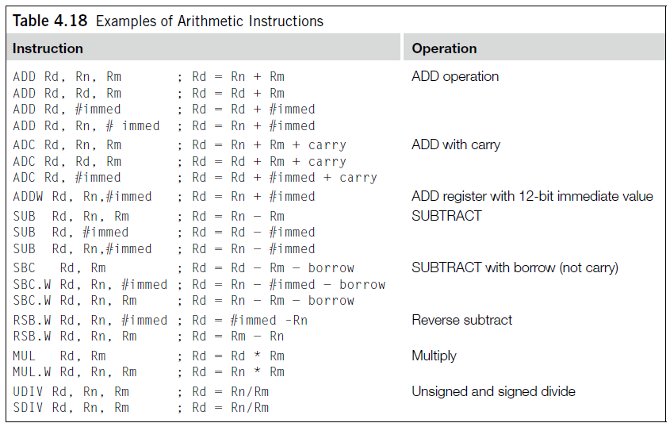
Assembler Language: Processing Data
Examples of Arithmetic Instructions

Slide 27
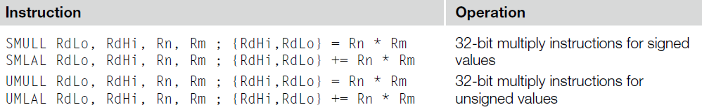
Assembler Language: Processing Data
32-Bit Multiply Instructions

Slide 28
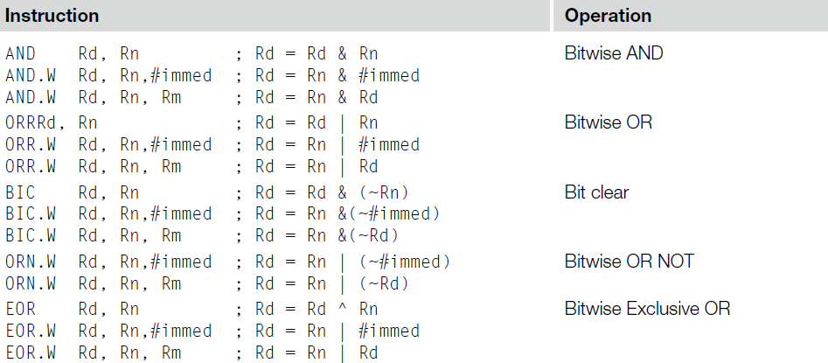
Assembler Language: Processing Data
Logic Operation Instructions

Slide 29
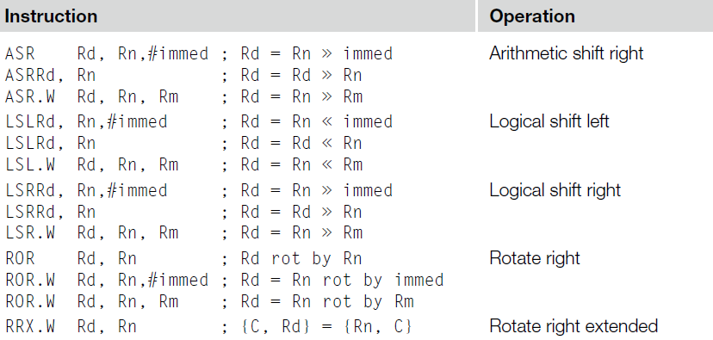
Assembler Language: Processing Data
Shift and Rotate Instructions

Slide 30
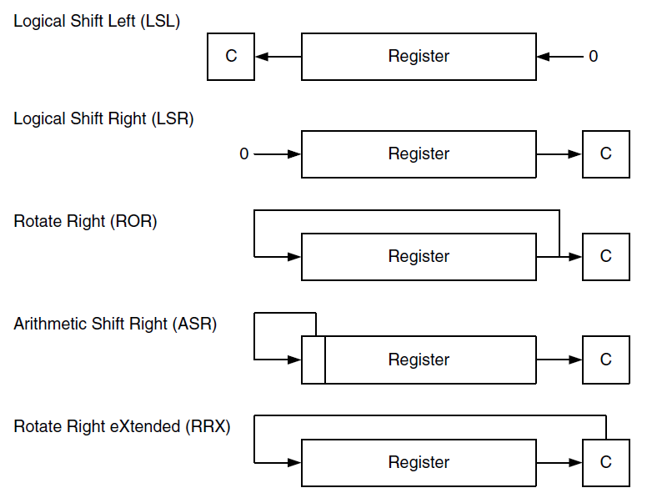
Assembler Language: Processing Data
Shift and Rotate Instructions

Slide 31
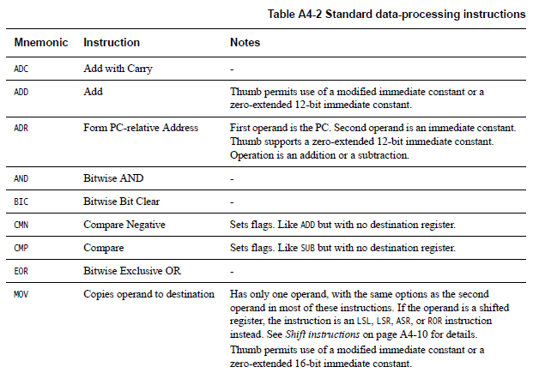
Assembler Language: Processing Data
More on
Many, Many More!

Slide 32
Instruction Descriptions
3-1) Assembler Language: Call and Unconditional Branch
Jump to the specified address that is expected to be executed
B label ; Branch to a labeled address
BX reg ; Branch to an address specified by a register
3-2) Assembler Language: Combined Compare and Conditional Branch
a simple compare with zero and conditional branch operations.
CBZ (compare and branch if zero)
CBNZ (compare and branch if nonzero).

Slide 33
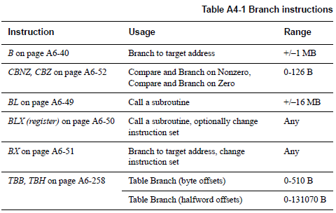
Branch

Slide 34
Branch examples
b label
Branch without link (i.e. no possibility of return) to label
The PC is not saved!
bx reg
Use to return from a function
Generally, lr is used for reg
Moves the lr value into the pc
Could be a different register than lr as well

Slide 35
Branch examples
bl label
Branch with link (call) to function label
Store the return address in the link register (lr)
blx reg
Branch to address specified by reg
Save return address in lr
When using blx, makre sure lsb of reg is 1 (otherwise, the CPU will fault b/c it’s an attempt to go into the ARM state)

Slide 36


Branch examples
Bx label, blx label
But since Cortex M-3 does not support ARM state, this instruction causes a fault!
Without branch instruction, branch is possible
Use MOV and LDR

Slide 37
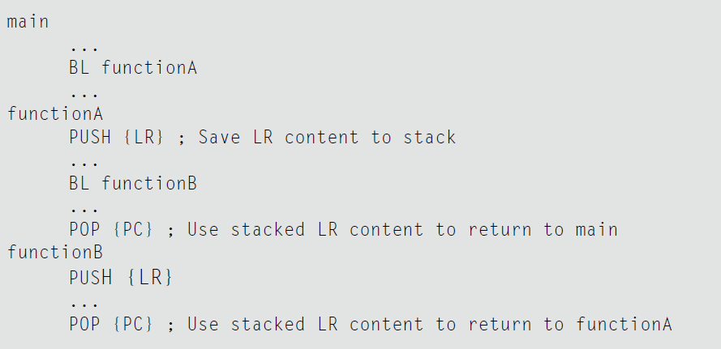
Branch examples
Calling bl overwrites contents of lr!
So, save lr if your function needs to call a function!

Slide 38
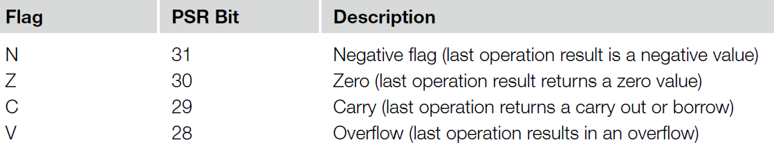
Conditional Branch
Most conditional branches in ARM processors use flags in the APSR to determine whether a branch should be carried out.
In the APSR, there are five flag bits; four of them are used for branch decisions

Slide 39
Flags in ARM Processors
Data processing instructions change the flags in the PSR
The flags might be used for branch decisions
Z (Zero) flag:
This flag is set when the result of an instruction has a zero value or when a comparison of two data returns an equal result.
N (Negative) flag:
This flag is set when the result of an instruction has a negative value (bit 31 is 1).
C (Carry) flag:
This flag is for unsigned data processing—for example, in add (ADD) it is set when an overflow occurs; in subtract (SUB) it is set when a borrow did not occur (borrow is the invert of carry).
V (Overflow) flag:
This flag is for signed data processing; for example, in an add (ADD), when two positive values added together produce a negative value, or when two negative values added together produce a positive value.

Slide 40
Application Program Status Register (APSR)

Slide 41
Use of Suffixes
4) Assembler Language: Use of Suffixes
In assembler for ARM processors, instructions can be followed by suffixes
The conditional execution suffixes are usually used for branch instructions

Slide 42
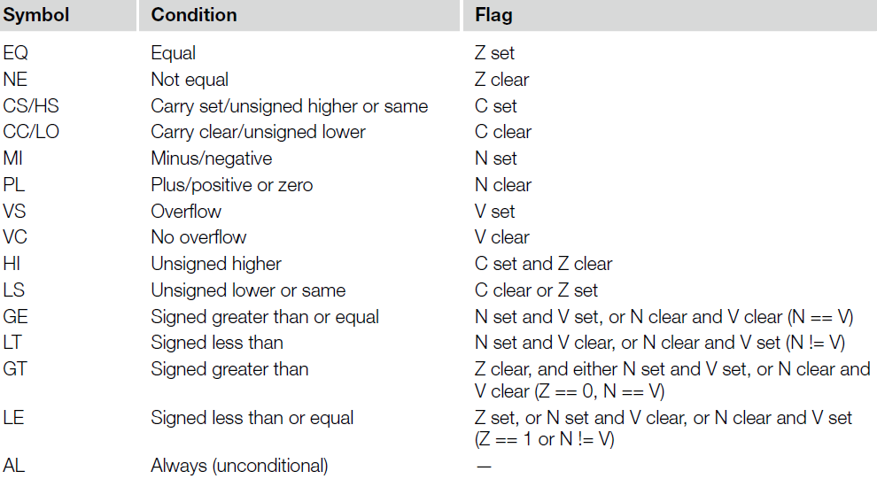
Use of Suffixes
Conditions for Branches or Other Conditional Operations

Slide 43
Updating the APSR
SUB Rx, Ry
Rx = Rx - Ry
APSR unchanged
SUBS
Rx = Rx - Ry
APSR N, Z, C, V updated
ADD Rx, Ry
Rx = Rx + Ry
APSR unchanged
ADDS
Rx = Rx + Ry
APSR N, Z, C, V updated

Slide 44
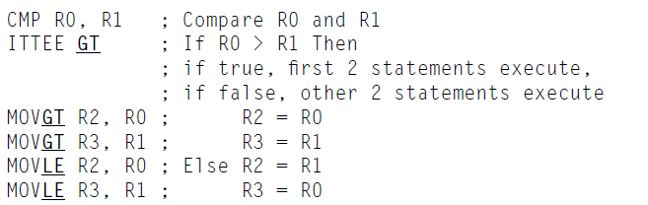
Use of Suffixes
Examples of using of Suffixes

Slide 45
Exercise: What is the value of r2 at done?
...
start:
movs r0, #1
movs r1, #1
movs r2, #1
sub r0, r1
bne done
movs r2, #2
done:
b done
...

Slide 46
Summary
Cortex M-3 Instruction Set Architecture
Cortex M-3 Instruction details
Data moving
Data processing
Branch
Use suffixes

